Slide 1
Collection API

Slide 2
Collections in Java
The Collection in Java is a framework that provides an architecture to store and manipulate the group of objects.
Java Collections can achieve all the operations that you perform on a data such as searching, sorting, insertion, manipulation, and deletion.
Java Collection means a single unit of objects. Java Collection framework provides many interfaces (Set, List, Queue, Deque) and classes (ArrayList, Vector ,LinkedList, PriorityQueue, HashSet, LinkedHashSet, TreeSet).

Slide 3
What is Collection in Java
A Collection represents a single unit of objects, i.e., a group.
What is a framework in Java
It provides readymade architecture.
It represents a set of classes and interfaces.
It is optional.
What is Collection framework
The Collection framework represents a unified architecture for storing and manipulating a group of objects. It has:
Interfaces and its implementations, i.e., classes
Algorithm

Slide 4
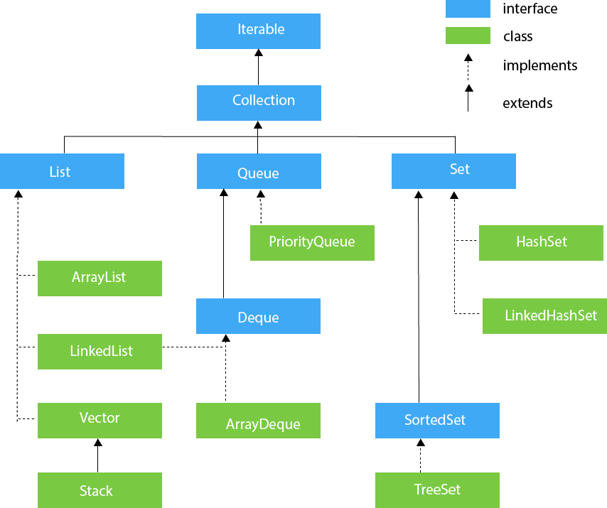
Hierarchy of Collection Framework. The java.util package contains all the classes and interfaces for the Collection framework.

Slide 5
Methods of Collection interface
No. | Method | Description
1 | public boolean add(E e) | It is used to insert an element in this collection.
2 | public boolean addAll(Collection<? extends E> c) | It is used to insert the specified collection elements in the invoking collection.
3 | public boolean remove(Object element) | It is used to delete an element from the collection.
4 | public boolean removeAll(Collection<?> c) | It is used to delete all the elements of the specified collection from the invoking collection.
5 | default boolean removeIf(Predicate<? super E> filter) | It is used to delete all the elements of the collection that satisfy the specified predicate.
6 | public boolean retainAll(Collection<?> c) | It is used to delete all the elements of invoking collection except the specified collection.
7 | public int size() | It returns the total number of elements in the collection.
8 | public void clear() | It removes the total number of elements from the collection.
9 | public boolean contains(Object element) | It is used to search an element.
10 | public boolean containsAll(Collection<?> c) | It is used to search the specified collection in the collection.
11 | public Iterator iterator() | It returns an iterator.

Slide 6
Iterator interface:Iterator interface provides the facility of iterating the elements in a forward direction only. Methods of Iterator interface There are only three methods in the Iterator interface. They are:
No. | Method | Description
1 | public boolean hasNext() | It returns true if the iterator has more elements otherwise it returns false.
2 | public Object next() | It returns the element and moves the cursor pointer to the next element.
3 | public void remove() | It removes the last elements returned by the iterator. It is less used.

Slide 7
Iterable Interface
The Iterable interface is the root interface for all the collection classes. The Collection interface extends the Iterable interface and therefore all the subclasses of Collection interface also implement the Iterable interface.
It contains only one abstract method. i.e.,
Iterator<T> iterator()
It returns the iterator over the elements of type T.

Slide 8
Collection Interface
The Collection interface is the interface which is implemented by all the classes in the collection framework. It declares the methods that every collection will have. In other words, we can say that the Collection interface builds the foundation on which the collection framework depends.
Some of the methods of Collection interface are Boolean add ( Object obj), Boolean addAll ( Collection c), void clear(), etc. which are implemented by all the subclasses of Collection interface.

Slide 9

List Interface
List interface is the child interface of Collection interface. It inhibits a list type data structure in which we can store the ordered collection of objects. It can have duplicate values.
List interface is implemented by the classes ArrayList, LinkedList, Vector, and Stack.
To instantiate the List interface, we must use :
List <data-type> list1= new ArrayList();
List <data-type> list2 = new LinkedList();
List <data-type> list3 = new Vector();
List <data-type> list4 = new Stack();
There are various methods in List interface that can be used to insert, delete, and access the elements from the list.
The classes that implement the List interface Follows now!

Slide 10
ArrayList
The ArrayList class implements the List interface. It uses a dynamic array to store the duplicate element of different data types.
The ArrayList class maintains the insertion order and is non-synchronized.
The elements stored in the ArrayList class can be randomly accessed. Consider the following example
Output:
Ravi
Vijay
Ravi
Ajay
import java.util.*;
class TestJavaCollection1{
public static void main(String args[]){
ArrayList<String> list=new ArrayList<String>();//Creating arraylist
list.add("Ravi");//Adding object in arraylist
list.add("Vijay");
list.add("Ravi");
list.add("Ajay"); //Traversing list through Iterator
Iterator itr=list.iterator();
while(itr.hasNext()){
System.out.println(itr.next()); } } }

Slide 11
LinkedList LinkedList implements the Collection interface. It uses a doubly linked list internally to store the elements. It can store the duplicate elements. It maintains the insertion order and is not synchronized. In LinkedList, the manipulation is fast because no shifting is required.
import java.util.*;
public class TestJavaCollection2{
public static void main(String args[]){
LinkedList<String> al=new LinkedList<String>();
al.add("Ravi");
al.add("Vijay");
al.add("Ravi");
al.add("Ajay");
Iterator<String> itr=al.iterator();
while(itr.hasNext()){
System.out.println(itr.next());
} } }
Output:
Ravi
Vijay
Ravi
Ajay

Slide 12
Vector Vector uses a dynamic array to store the data elements. It is similar to ArrayList. However, It is synchronized and contains many methods that are not the part of Collection framework.
import java.util.*;
public class TestJavaCollection3{
public static void main(String args[]){
Vector<String> v=new Vector<String>();
v.add("Ayush");
v.add("Amit");
v.add("Ashish");
v.add("Garima");
Iterator<String> itr=v.iterator();
while(itr.hasNext()){
System.out.println(itr.next());
} } }
Output:
Ayush
Amit
Ashish
Garima

Slide 13

Queue Interface:
Queue interface maintains the first-in-first-out order. It can be defined as an ordered list that is used to hold the elements which are about to be processed. There are various classes like PriorityQueue, Deque, and ArrayDeque which implements the Queue interface.
Queue interface can be instantiated as:
Queue<String> q1 = new PriorityQueue();
Queue<String> q2 = new ArrayDeque();
There are various classes that implement the Queue interface

Slide 14
PriorityQueue: The PriorityQueue class implements the Queue interface. It holds the elements or objects which are to be processed by their priorities. PriorityQueue doesn't allow null values to be stored in the queue.
import java.util.*;
public class TestJavaCollection5{
public static void main(String args[]){
PriorityQueue<String> queue=new PriorityQueue<String>();
queue.add("Amit Sharma");
queue.add("Vijay Raj");
queue.add("JaiShankar");
queue.add("Raj"); System.out.println("head:"+queue.element());
System.out.println("head:"+queue.peek());
System.out.println("iterating the queue elements:");
Iterator itr=queue.iterator();
while(itr.hasNext()){
System.out.println(itr.next()); }
queue.remove();
queue.poll();
System.out.println("after removing two elements:");
Iterator<String> itr2=queue.iterator();
while(itr2.hasNext()){
System.out.println(itr2.next()); } } }

Slide 15
Output:
head:Amit Sharma
head:Amit Sharma
iterating the queue elements:
Amit Sharma
Raj
JaiShankar
Vijay Raj
after removing two elements:
Raj
Vijay Raj

Slide 16
HashSet: HashSet class implements Set Interface. It represents the collection that uses a hash table for storage. Hashing is used to store the elements in the HashSet. It contains unique items.
import java.util.*;
public class TestJavaCollection7{
public static void main(String args[]){
//Creating HashSet and adding elements
HashSet<String> set=new HashSet<String>();
set.add("Ravi");
set.add("Vijay");
set.add("Ravi");
set.add("Ajay");
//Traversing elements
Iterator<String> itr=set.iterator();
while(itr.hasNext()){
System.out.println(itr.next()); } }}
Output:
Vijay
Ravi
Ajay

Slide 17
LinkedHashSet:LinkedHashSet class represents the LinkedList implementation of Set Interface. It extends the HashSet class and implements Set interface. Like HashSet, It also contains unique elements. It maintains the insertion order and permits null elements.
import java.util.*;
public class TestJavaCollection8{
public static void main(String args[]){
LinkedHashSet<String> set=new LinkedHashSet<String>();
set.add("Ravi");
set.add("Vijay");
set.add("Ravi");
set.add("Ajay");
Iterator<String> itr=set.iterator();
while(itr.hasNext()){
System.out.println(itr.next()); } } }
Output:
Ravi
Vijay
Ajay

Slide 18
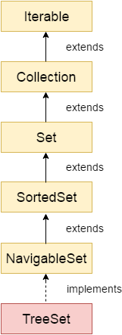
Java TreeSet class
Hierarchy of TreeSet class
Java TreeSet class implements the Set interface that uses a tree for storage.
It inherits AbstractSet class and implements the NavigableSet interface.
The objects of the TreeSet class are stored in ascending order. The important points about Java TreeSet class are:
Java TreeSet class contains unique elements only like HashSet.
Java TreeSet class access and retrieval times are quiet fast.
Java TreeSet class doesn't allow null element.
Java TreeSet class is non synchronized.
Java TreeSet class maintains ascending order.

Slide 19
Constructors of Java TreeSet class
Method | Description
boolean add(E e) | It is used to add the specified element to this set if it is not already present.
boolean addAll(Collection<? extends E> c) | It is used to add all of the elements in the specified collection to this set.
E ceiling(E e) | It returns the equal or closest greatest element of the specified element from the set, or null there is no such element.
Comparator<? super E> comparator() | It returns comparator that arranged elements in order.
Iterator descendingIterator() | It is used iterate the elements in descending order.
Constructor | Description
TreeSet() | It is used to construct an empty tree set that will be sorted in ascending order according to the natural order of the tree set.
TreeSet(Collection<? extends E> c) | It is used to build a new tree set that contains the elements of the collection c.
TreeSet(Comparator<? super E> comparator) | It is used to construct an empty tree set that will be sorted according to given comparator.
TreeSet(SortedSet<E> s) | It is used to build a TreeSet that contains the elements of the given SortedSet.

Slide 20
import java.util.*;
class TreeSet1{
public static void main(String args[]){
//Creating and adding elements
TreeSet<String> al=new TreeSet<String>();
al.add("Ravi");
al.add("Vijay");
al.add("Ravi");
al.add("Ajay");
//Traversing elements
Iterator<String> itr=al.iterator();
while(itr.hasNext()){
System.out.println(itr.next()); } } }
Ajay
Ravi
Vijay
import java.util.*;
class TreeSet2{
public static void main(String args[]){
TreeSet<String> set=new TreeSet<String>();
set.add("Ravi");
set.add("Vijay");
set.add("Ajay");
System.out.println("Traversing element through Iterator in descending order");
Iterator i=set.descendingIterator();
while(i.hasNext())
{ System.out.println(i.next()); } } }
Output:
Traversing element through Iterator in descending order
Vijay
Ravi
Ajay
Traversing element through NavigableSet in descending order
Vijay
Ravi
Ajay

Slide 21
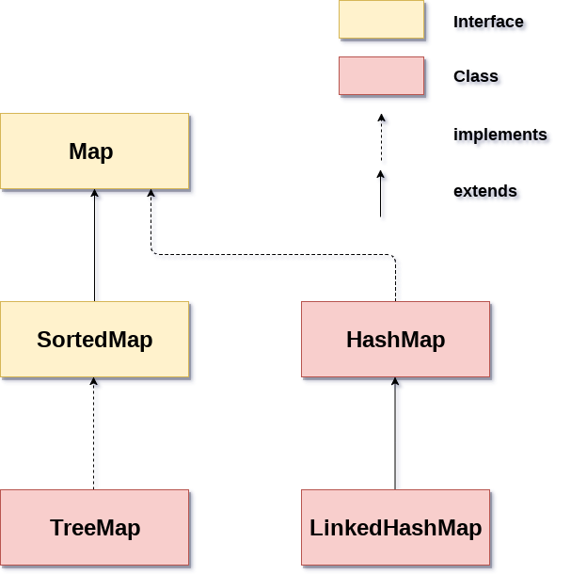
Java Map Interface:A map contains values on the basis of key, i.e. key and value pair. Each key and value pair is known as an entry. A Map contains unique keys.
A Map is useful if you have to search, update or delete elements on the basis of a key. Java Map Hierarchy
There are two interfaces for implementing Map in java: Map and SortedMap, and three classes: HashMap, LinkedHashMap, and TreeMap. The hierarchy of Java Map is given: A Map doesn't allow duplicate keys, but you can have duplicate values. HashMap and LinkedHashMap allow null keys and values, but TreeMap doesn't allow any null key or value.

Slide 22
A Map can't be traversed, so you need to convert it into Set using keySet() or entrySet() method.
Method | Description
V put(Object key, Object value) | It is used to insert an entry in the map.
void putAll(Map map) | It is used to insert the specified map in the map.
V putIfAbsent(K key, V value) | It inserts the specified value with the specified key in the map only if it is not already specified.
V remove(Object key) | It is used to delete an entry for the specified key.
boolean remove(Object key, Object value) | It removes the specified values with the associated specified keys from the map.
Set keySet() | It returns the Set view containing all the keys.
Class | Description
HashMap | HashMap is the implementation of Map, but it doesn't maintain any order.
LinkedHashMap | LinkedHashMap is the implementation of Map. It inherits HashMap class. It maintains insertion order.
TreeMap | TreeMap is the implementation of Map and SortedMap. It maintains ascending order.

Slide 23
Java Map Example: Non-Generic (Old Style)
Java Map Example: Generic (New Style)
import java.util.*;
class MapExample2{
public static void main(String args[]){
Map<Integer,String> map=new HashMap<Integer,String>();
map.put(100,"Amit");
map.put(101,"Vijay");
map.put(102,"Rahul");
//Elements can traverse in any order
for(Map.Entry m:map.entrySet()){
System.out.println(m.getKey()+" "+m.getValue());
}
}
}
Output:
102 Rahul
100 Amit
101 Vijay
import java.util.*;
public class MapExample1 {
public static void main(String[] args) {
Map map=new HashMap(); //Adding elements to map
map.put(1,"Amit");
map.put(5,"Rahul");
map.put(2,"Jai");
map.put(6,"Amit"); //Traversing Map
Set set=map.entrySet();//Converting to Set so that we can traverse
Iterator itr=set.iterator();
while(itr.hasNext()){ //Converting to Map.Entry so that we can get key and value separately
Map.Entry entry=(Map.Entry)itr.next();
System.out.println(entry.getKey()+" "+entry.getValue());
} } }
Output:
1 Amit
2 Jai
5 Rahul
6 Amit

Slide 24
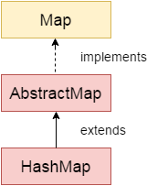
Java HashMap
Java HashMap class implements the Map interface which allows us to store key and value pair, where keys should be unique.
If you try to insert the duplicate key, it will replace the element of the corresponding key.
It is easy to perform operations using the key index like updation, deletion, etc. HashMap class is found in the java.util package.
HashMap in Java is like the legacy Hashtable class, but it is not synchronized.
It allows us to store the null elements as well, but there should be only one null key. Since Java 5, it is denoted as HashMap<K,V>, where K stands for key and V for value. It inherits the AbstractMap class and implements the Map interface.

Slide 25
Method | Description
void clear() | It is used to remove all of the mappings from this map.
boolean isEmpty() | It is used to return true if this map contains no key-value mappings.
Object clone() | It is used to return a shallow copy of this HashMap instance: the keys and values themselves are not cloned.
Set entrySet() | It is used to return a collection view of the mappings contained in this map.
Set keySet() | It is used to return a set view of the keys contained in this map.
V put(Object key, Object value) | It is used to insert an entry in the map.
void putAll(Map map) | It is used to insert the specified map in the map.
Constructor | Description
HashMap() | It is used to construct a default HashMap.
HashMap(Map<? extends K,? extends V> m) | It is used to initialize the hash map by using the elements of the given Map object m.
HashMap(int capacity) | It is used to initializes the capacity of the hash map to the given integer value, capacity.
HashMap(int capacity, float loadFactor) | It is used to initialize both the capacity and load factor of the hash map by using its arguments.

Slide 26
Java HashMap Example
import java.util.*;
public class HashMapExample1{
public static void main(String args[]){
HashMap<Integer,String> map=new HashMap<Integer,String>();//Creating HashMap
map.put(1,"Mango"); //Put elements in Map
map.put(2,"Apple");
map.put(3,"Banana");
map.put(4,"Grapes");
System.out.println("Iterating Hashmap...");
for(Map.Entry m : map.entrySet()){
System.out.println(m.getKey()+" "+m.getValue());
} } }
Iterating Hashmap...
1 Mango
2 Apple
3 Banana
4 Grapes
In this example, we are storing Integer as the key and String as the value, so we are using HashMap<Integer,String> as the type. The put() method inserts the elements in the map.
To get the key and value elements, we should call the getKey() and getValue() methods. The Map.Entry interface contains the getKey() and getValue() methods. But, we should call the entrySet() method of Map interface to get the instance of Map.Entry.

